Slide 2
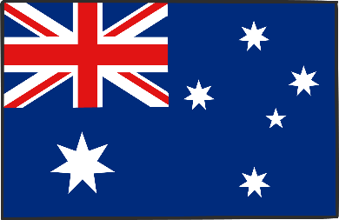
Australia
In Australia, the Easter bilby is an alternative to the Easter bunny.
Chocolate bilbies are eaten as well as chocolate rabbits.
Rabbits are considered pests in Australia.

Slide 3
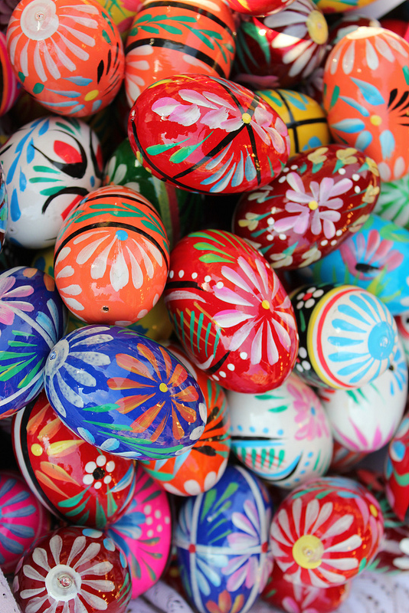
Poland
On Easter Monday, boys roam around the streets and sprinkle girls with water or perfume.
Baskets of food are taken to church to be blessed.
On Easter Sunday, eggs are eaten and also a cake in the shape of a lamb to symbolise Christ.
They also have painted Easter eggs called pisanki that are handcrafted and painted with traditional symbols of fertility and spring.
Photo courtesy of praktyczny.przewodnik (@flickr.com) - granted under creative commons licence – attribution

Slide 4
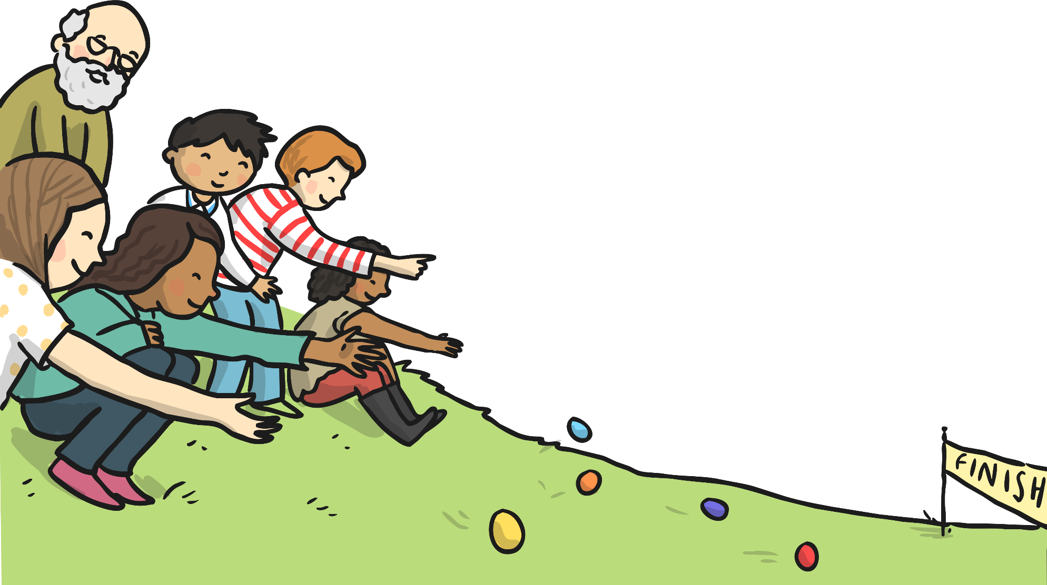
Scotland
In Scotland, they have egg rolling competitions.
Eggs are boiled and then painted.
Children then roll eggs down grassy hills. Whoever’s egg rolls the farthest wins.
The rolling of the egg symbolises the rolling away of the stone from Jesus’ tomb.

Slide 5
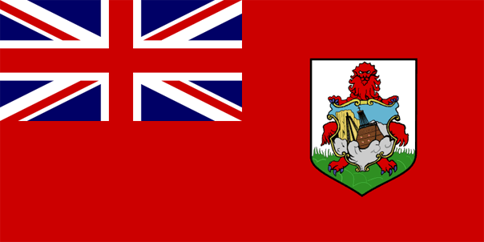
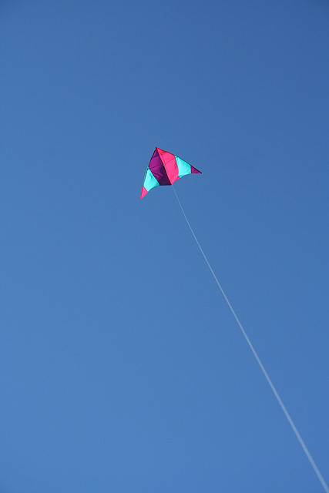
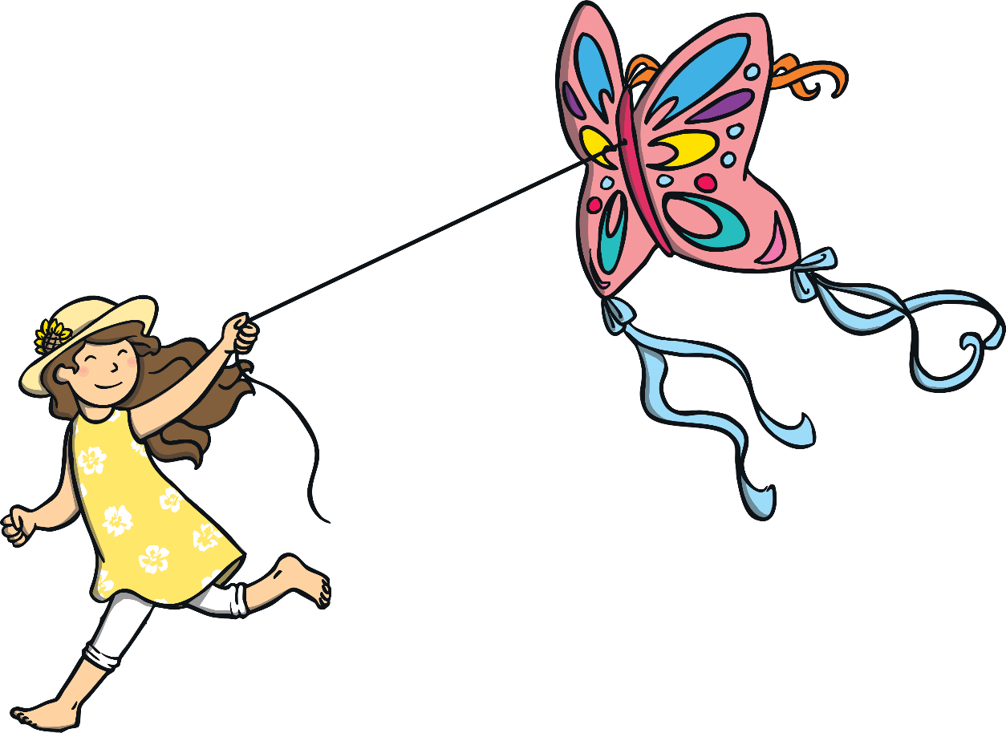
Bermuda
In Bermuda, people fly kites to symbolise the rising of Christ.
Photo courtesy of mr.bologna (@flickr.com) - granted under creative commons licence – attribution

Slide 6
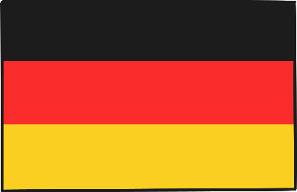
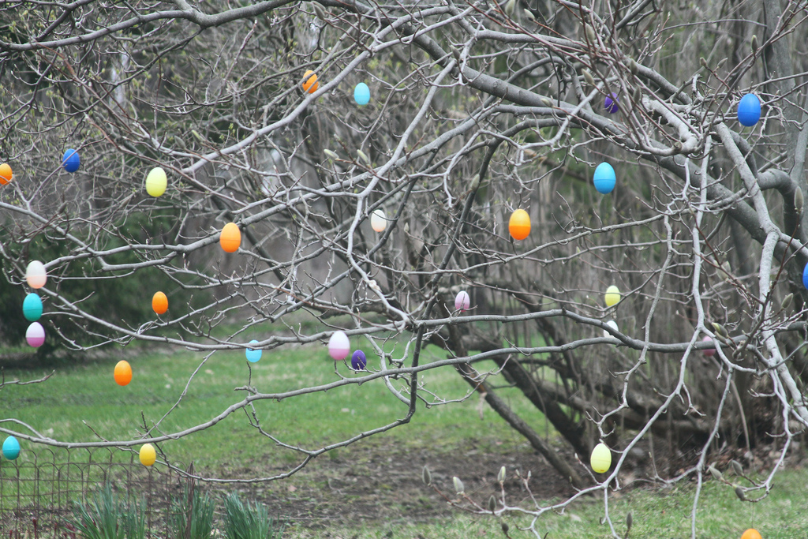
Germany
In Germany, they have Easter egg trees called ostereierbaum.
Decorated eggs are hung from the branches of the tree.
Photo courtesy of waitscm (@flickr.com) - granted under creative commons licence – attribution

Slide 7
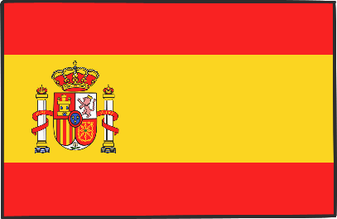
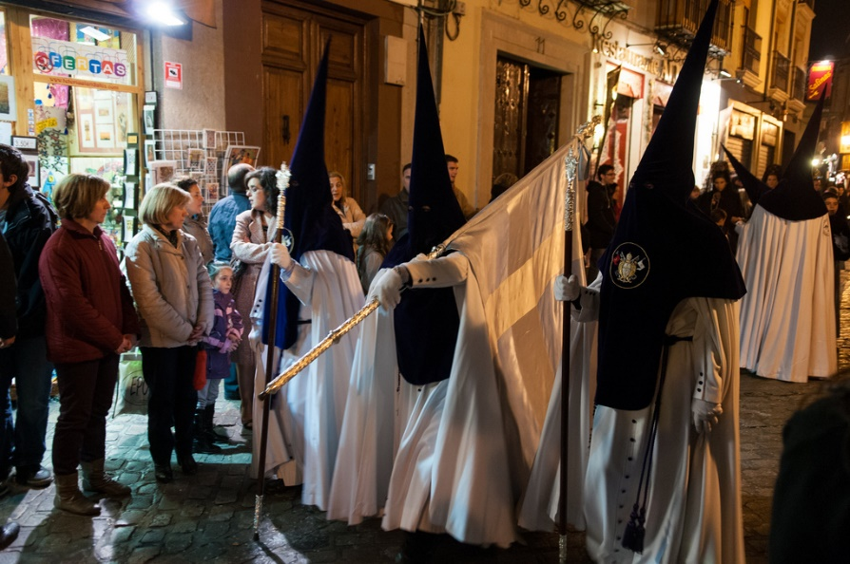
Spain
In Spain, boys and girls bang drums during church processions.
Spain also has parades with pasos or thrones illustrating the Easter story and marching bands. The parades are followed by cloaked people seeking forgiveness from God.
Children bring palm leaves to church on Palm Sunday. People decorate their branches with flowers.
On Ash Wednesday, a cross of ash is put onto people’s foreheads to say sorry to God for the bad things they have done.
In some places, on Maundy Thursday, men dress as skeletons to perform a dance of death to symbolise Jesus’ death.
Photo courtesy of waitscm (@flickr.com) - granted under creative commons licence – attribution

Slide 8
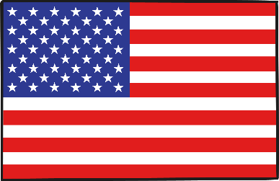
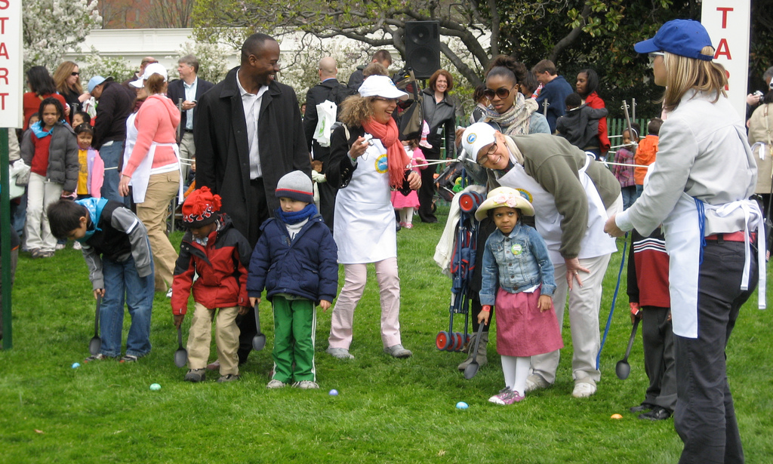
USA
At the White House in Washington DC, USA, there is an Easter egg rolling event held every year.
Children push decorated eggs through the grass with long handled spoons.
In recent years celebrities have turned up to entertain the rollers!
Photo courtesy of creativedc (@flickr.com) - granted under creative commons licence – attribution

Slide 9
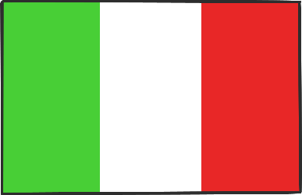
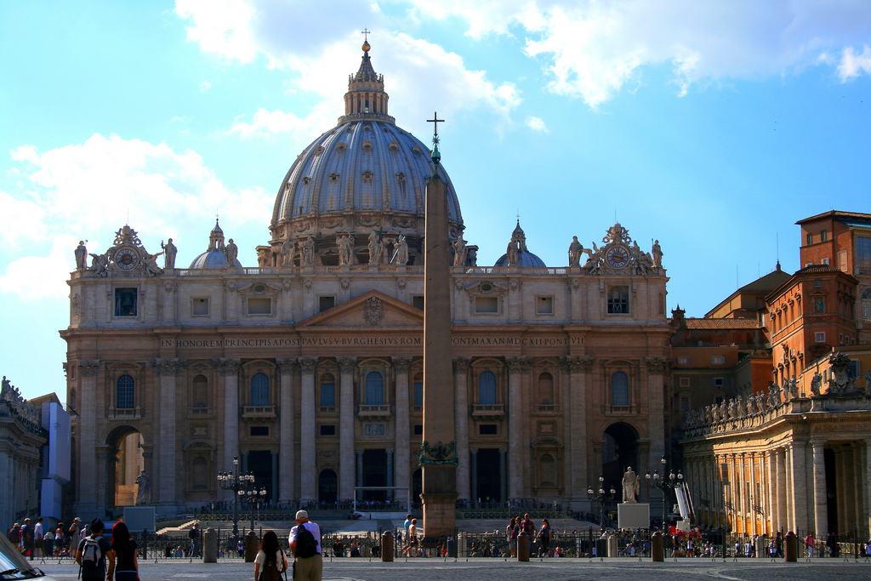
Italy
In Rome, Italy, the Pope washes the feet of a dozen men at a re-enactment of the Last Supper on Maundy Thursday.
On Good Friday, many people gather at Saint Peter’s Basilica to listen to the Pope’s mass at 5pm. The Pope has a candle-lit walk to remember Christ.
Photo courtesy of Averain (@flickr.com) - granted under creative commons licence – attribution

Slide 10
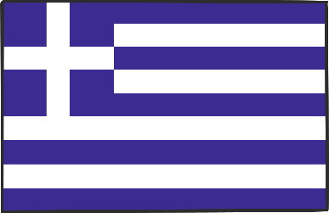
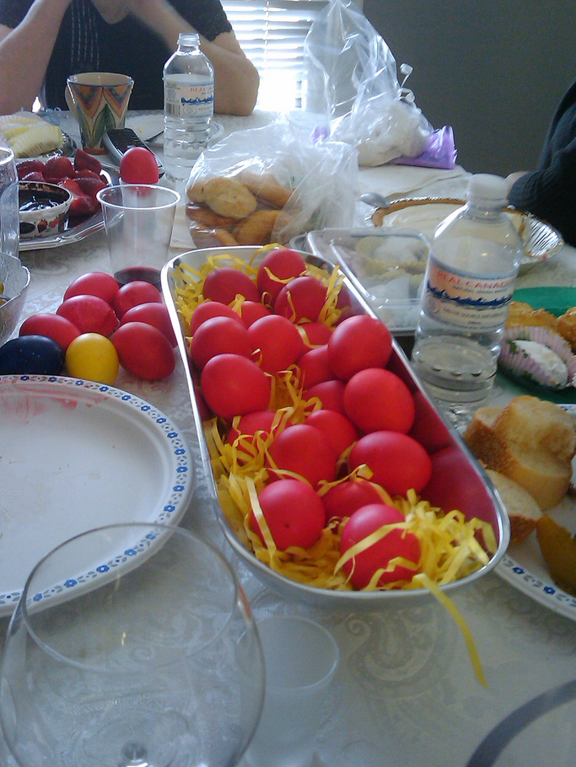
Greece
Easter festival begins before Easter.
On Maundy Thursday, Easter bread is baked and eggs are dyed red symbolising the blood of Christ.
On Holy Saturday, people attend midnight mass where they all bring a candle to light from the churches' Holy Flame.
Easter Sunday is spent with friends and family for a meal of roast lamb.
Photo courtesy of Julio.garciah (@flickr.com) - granted under creative commons licence – attribution

