Slide 1
Maths
27.03.20

Slide 2
Can you say one fact about each of these numbers?
10
99
50
64
32
18
15

Slide 3
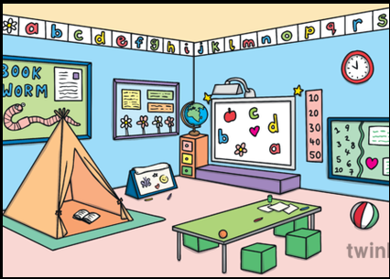
Look at the picture of the classroom. How many different 3D shapes can you spot?

Slide 4
Activity
Read my statements that I have written about 3D shapes. Can you say if they are true or false?
A cone has 2 faces. 1 is a circle.
A cuboid has 2 square faces and 2 rectangle faces.
A cube has 6 rectangle faces.
A pyramid has triangle faces.
A cylinder has 3 circle faces.
A sphere has no faces.

Slide 5
Challenge
Next to the statements that you think are false can you explain what the correct answer should be?
For example: A cone has 1 face- false
This is false because a cone has 2 faces.

