Slide 1
Maths
30.03.20

Slide 2
Look at the patterns. What comes next?

Slide 3
What does this symbol mean?
WALT: know and write simple fractions

Slide 4
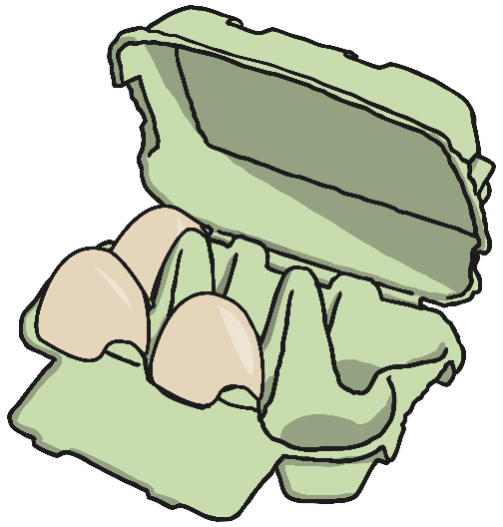
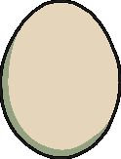
Which of these have been split into half?

Slide 5
Activity
Can you find half of each of these numbers? Record them in a number sentence in your exercise book e.g. ½ of 22 = 11
62
12
8
44
68
18
30
26
32
24

Slide 6
Challenge
Can you check that my halving is correct?
½ of 12 = 6
½ of 20 = 11
½ of 34 = 17
½ of 10 = 4
½ of 46 = 21
½ of 18 = 8

