Slide 2
National Curriculum Objective(s)
Identify right angles, recognise that two right angles make a half-turn, three make three quarters of a turn and four a complete turn; identify whether angles are greater than or less than a right angle.

Slide 3
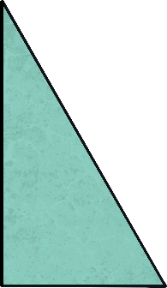
Recognise Right Angles in Shapes
Diving
Look at these shapes.
They each have a special type of angle called a right angle in one or more of their corners.

Slide 4
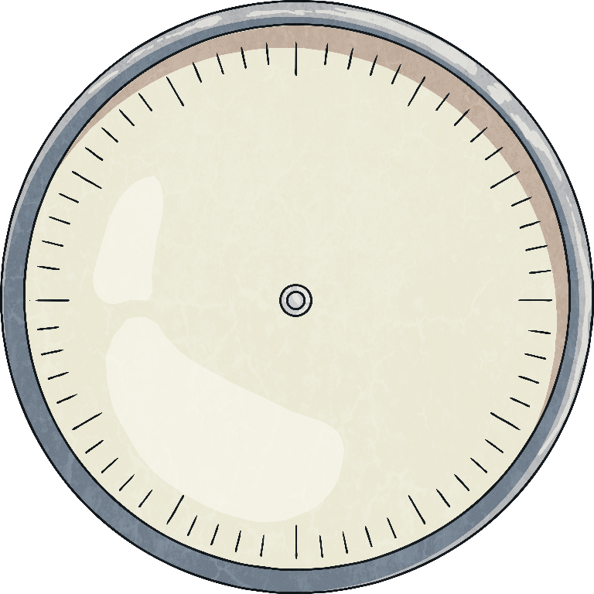
Recognise Right Angles in Shapes
Diving
We can also think of a right angle as a quarter turn.
Click to see the arrow make a quarter turn.

Slide 5
Recognise Right Angles in Shapes
Diving
Can you see any shapes here that have right angles in them?

Slide 6
Recognise Right Angles in Shapes
Deeper
Look at these letters:
HEN
Can you see right angles where any of the lines meet?

Slide 7
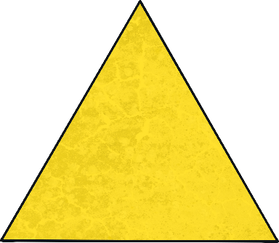
Recognise Right Angles in Shapes
Deeper
One of these shapes is different to the others:
Can you explain why?
This triangle is the only shape without a right angle.

Slide 8
Recognise Right Angles in Shapes
Deepest
Three children have drawn a shape each.
Can you match the child to their shape from their descriptions?
My shape has half the number of right angles that Joseph’s has.
Penny
My shape has as least double the number of right angles that Joseph’s shape has.
Angelina
My shape has the same number of right angles as a square.
Joseph

Slide 9
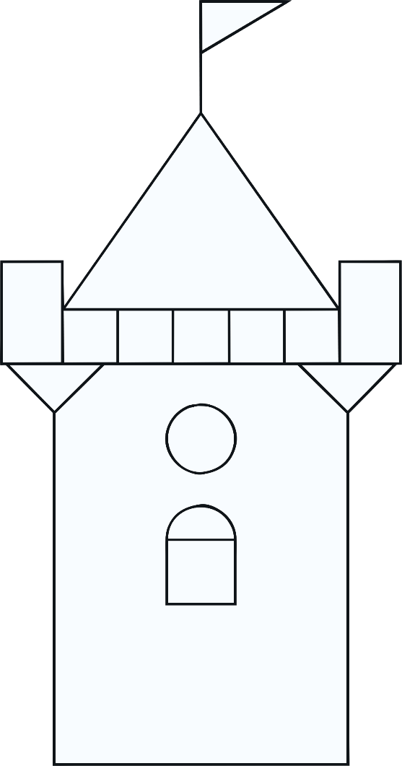
Recognise Right Angles in Shapes
Deepest
Look at this picture.
How many right angles can you spot in it?

Slide 10
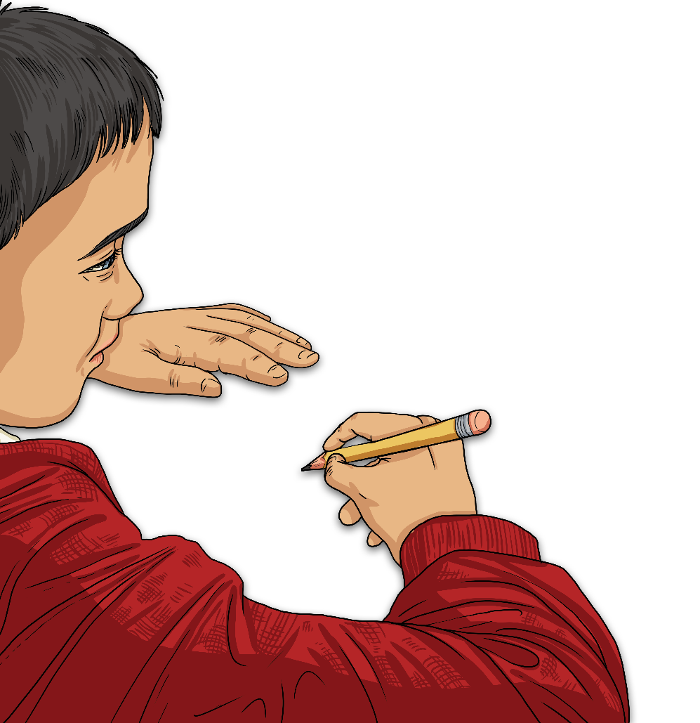
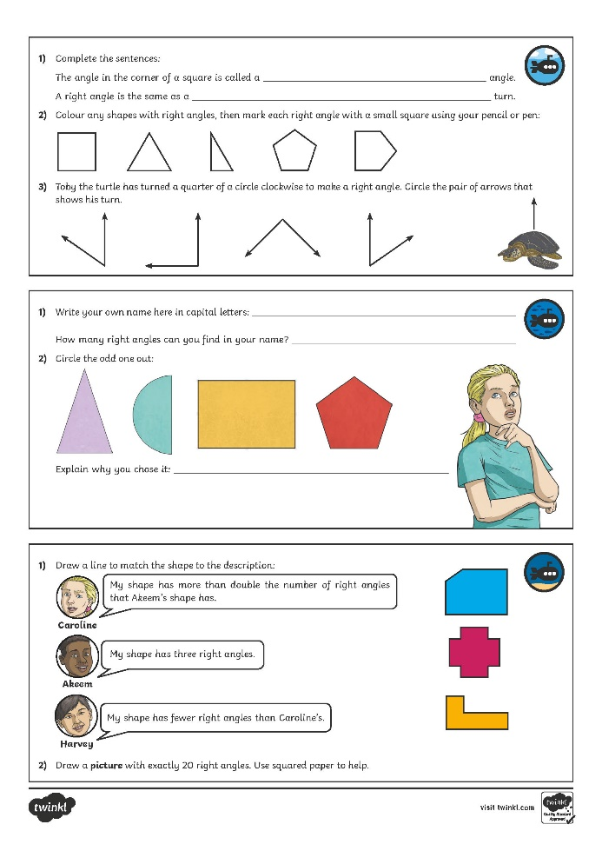
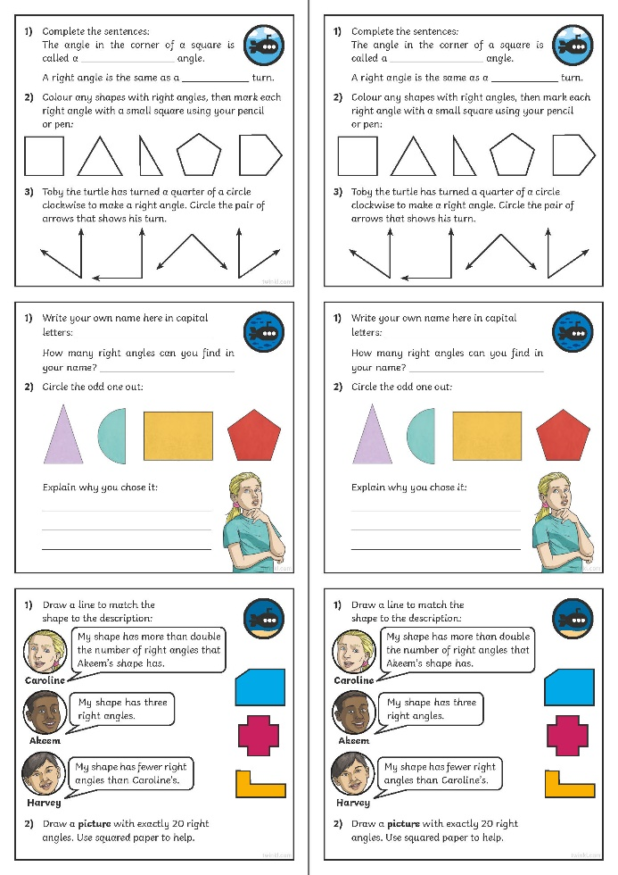
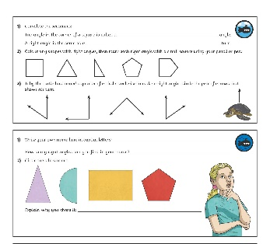
Recognise Right Angles in Shapes
Dive in by completing your own activity!

