Slide 1
Maths
31.03.20

Slide 2
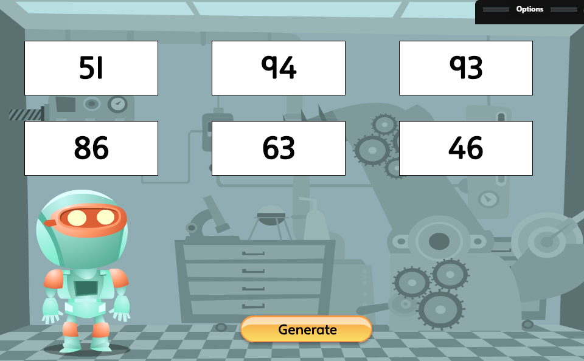
What number sentences can you write for one of these numbers? Remember you can add, take away, multiply or divide!

Slide 3
What does this symbol mean?
WALT: know and write simple fractions

Slide 4
Remember ¼ means splitting things into 4 equal groups. Look at the pictures to help.

Slide 5
Activity
Can you find 1/4 of each of these numbers? Record them in a number sentence in your exercise book e.g. 1/4 of 20 = 5
8
24
20
40
12
16
28

Slide 6
Challenge
Can you solve this problem?
Sammie is 16 years old. His little brother is ¼ of his age. How old is Sammie’s brother?

