Slide 1
Writing
1st April 2020

Slide 2
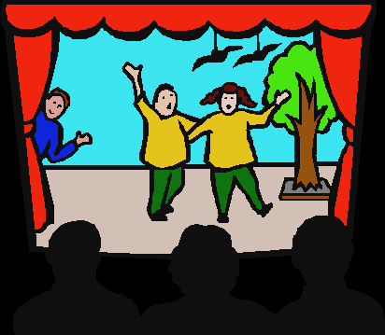
Warm Up Game:
Watch the following people performing poems:
https://www.youtube.com/watch?v=ByAg5aoyAN4
What makes their performances interesting?

Slide 3
WALT: perform a poem or part of a poem from heart
Select your favourite verse from ‘The magic of the brain’ poem.
Create a performance of this part of the poem. Remember to try and include:
Appropriate actions
Clear voice
Good expression
Know the words of the verse

Slide 4
Challenge
Perform your poem to your family and friends. What do they like about your performance?

