Slide 1
Writing
24th March 2020

Slide 2
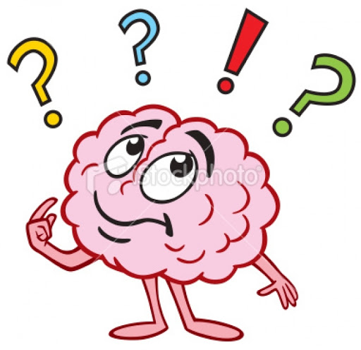
WALT: write extended sentences using subordinating conjunctions
What is a conjunction?
What does it do?
Can you think of any examples of subordinating conjunctions?

Slide 3
Subordinating Conjunctions
A conjunction is a word that connects two parts (clauses) of a sentence together
Examples of subordinating conjunctions include:

Slide 4
What does an extended sentence need to be successful?
Start with a capital letter
End with a full stop or perhaps an exclamation mark
Use a subordinating conjunction to link two connected ideas together
Correct spelling
Make sense when you read it aloud

Slide 5
Activity:
Take a look at my sentences on the next slide.
Can you read them aloud?
Are they successful?
What do you need to change to make them successful?
Write the sentences out correctly in your exercise book. Underline any changes you had to make using a coloured pencil.

Slide 6
Sentences:
tom went to the supermarket Because hee needed bread.
I will visit the beech when it get hotter
Harry put on his clothes After he brushed hiss teef
sarah sung a song while she read her boock.
Mason put on his coat Before he whent outside!
georgina was feeling verry happy because she did well in spelling test
Jack ate his lunch while his friends play?
Annie would visit her grandmother if she was not feeling well,

